Slide 1

DICOM Management System By Mennatullah Mahmoud and Menna Abdelsattar
BMd303

Slide 2
Project Management
plan
execute
progress

Slide 3
introduction
Applications are an essential factor in our life as it improves and facilitates all our needs.
DICOM means digital imaging and communications in medicine which is standard for the communication and management of medical imaging information and related data.
DICOM Management system is a web based application to store, upload, visualize and read DICOM files.
It is an information system that is developed by python and Django framework connected to SQLite database, a server created by simplifier.net and Fhirpy library of HL7 which contain all the data and resources needed by the application.

Slide 4
Aim of the app
The app mainly focuses to ease the system of DICOM by a unique modern management system.
Users will be able to save all records data effectively and safely with few clicks.
Users can view and read DICOM files.
Users can upload DICOM that is related to patients.
Users can view all the records that is stored in the database.
Users can add new record of patients.
Users can view the details of each record.

Slide 5
Benefits of the app
The system is organizational as it provides a larger possibility of documentation
Improvement of operational efficiency
Better interdepartmental communication
Improvement of data accuracy and easy access to data for further research.
All the options needed are provided by the app so that it’s useful for both doctor and patient and any laboratory user besides its efficiency that gives a comfortability in use to the users of the clinics.

Slide 6
Technologies used in the app
Python
Django
SQLite database
fhirpy

Slide 7
App details
Login
All Records
Add New Record (DICOM upload)
Details

Slide 8
Registration
Login is the landing page of the application
the user will be asked to enter their e-mail and password
Once they are authenticated, they will be able to access the rest of the app.

Slide 9


Slide 10
All Records
This page allows the admin to visualize all the records stored in the database. It includes the patient id, name, contact number, national id, modality and details page.

Slide 11
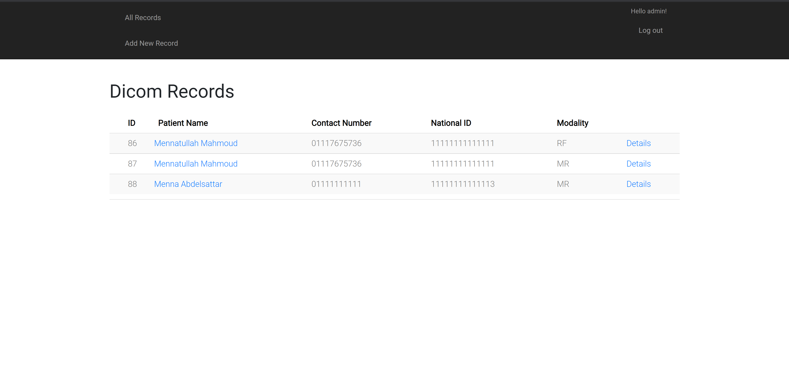

Slide 12
Add New Record (DICOM Upload)
This page allows the user to add new record. User has to enter the patient’s national id and modality. After that choose the DICOM file to upload and submit it.
Users write the national id of patient to get the patient
Users choose the modality type if it is CR Computed Radiography or CT Computed Tomography or MR Magnetic Resonance or NM Nuclear Medicine.
On clicking on choose file, user chooses the DICOM file to be uploaded
on clicking on submit, the DICOM file will be submitted and saved.

Slide 13
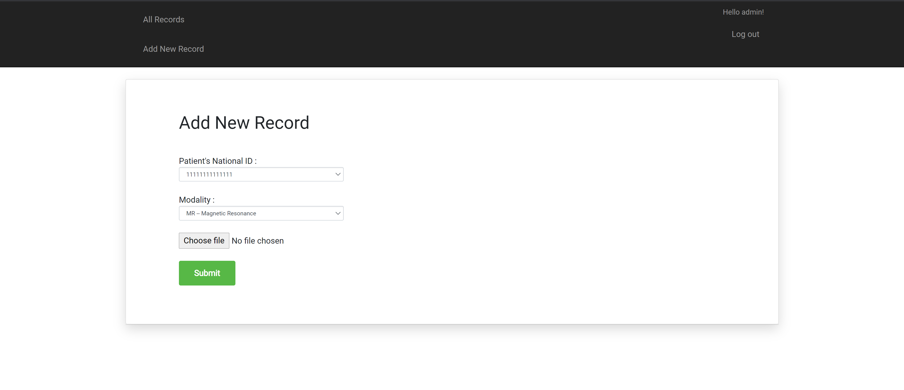

Slide 14
Details
The details section allows the user to view all the details of each record of patient.

Slide 15
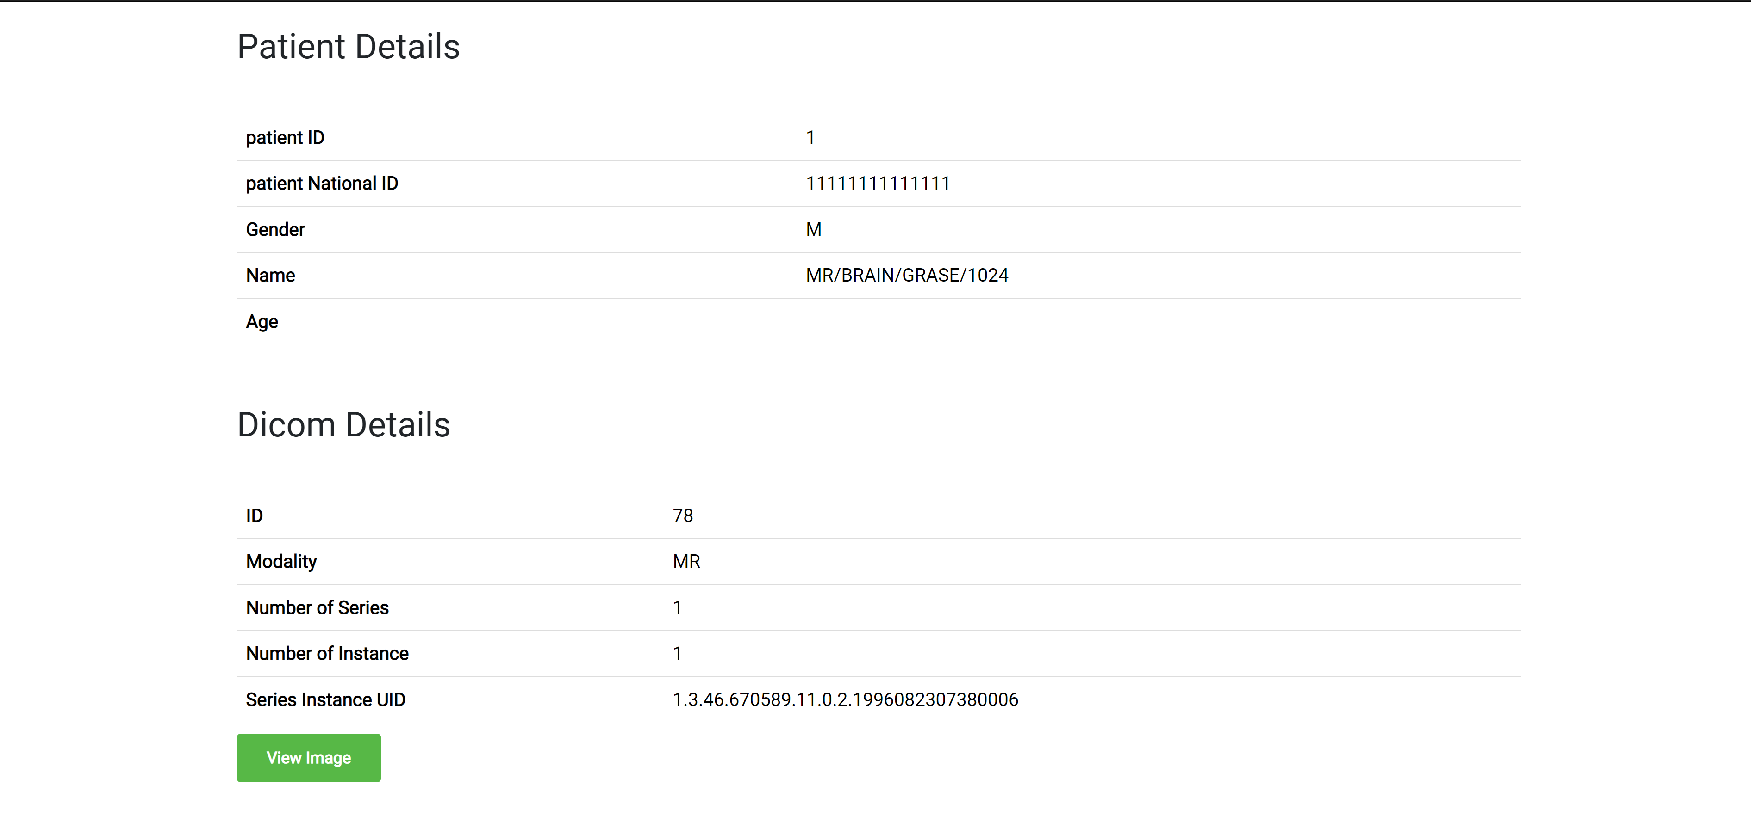

Slide 16
Viewing the Dicom Image
Here we visualize the image, we can zoom, move or save the image

Slide 17
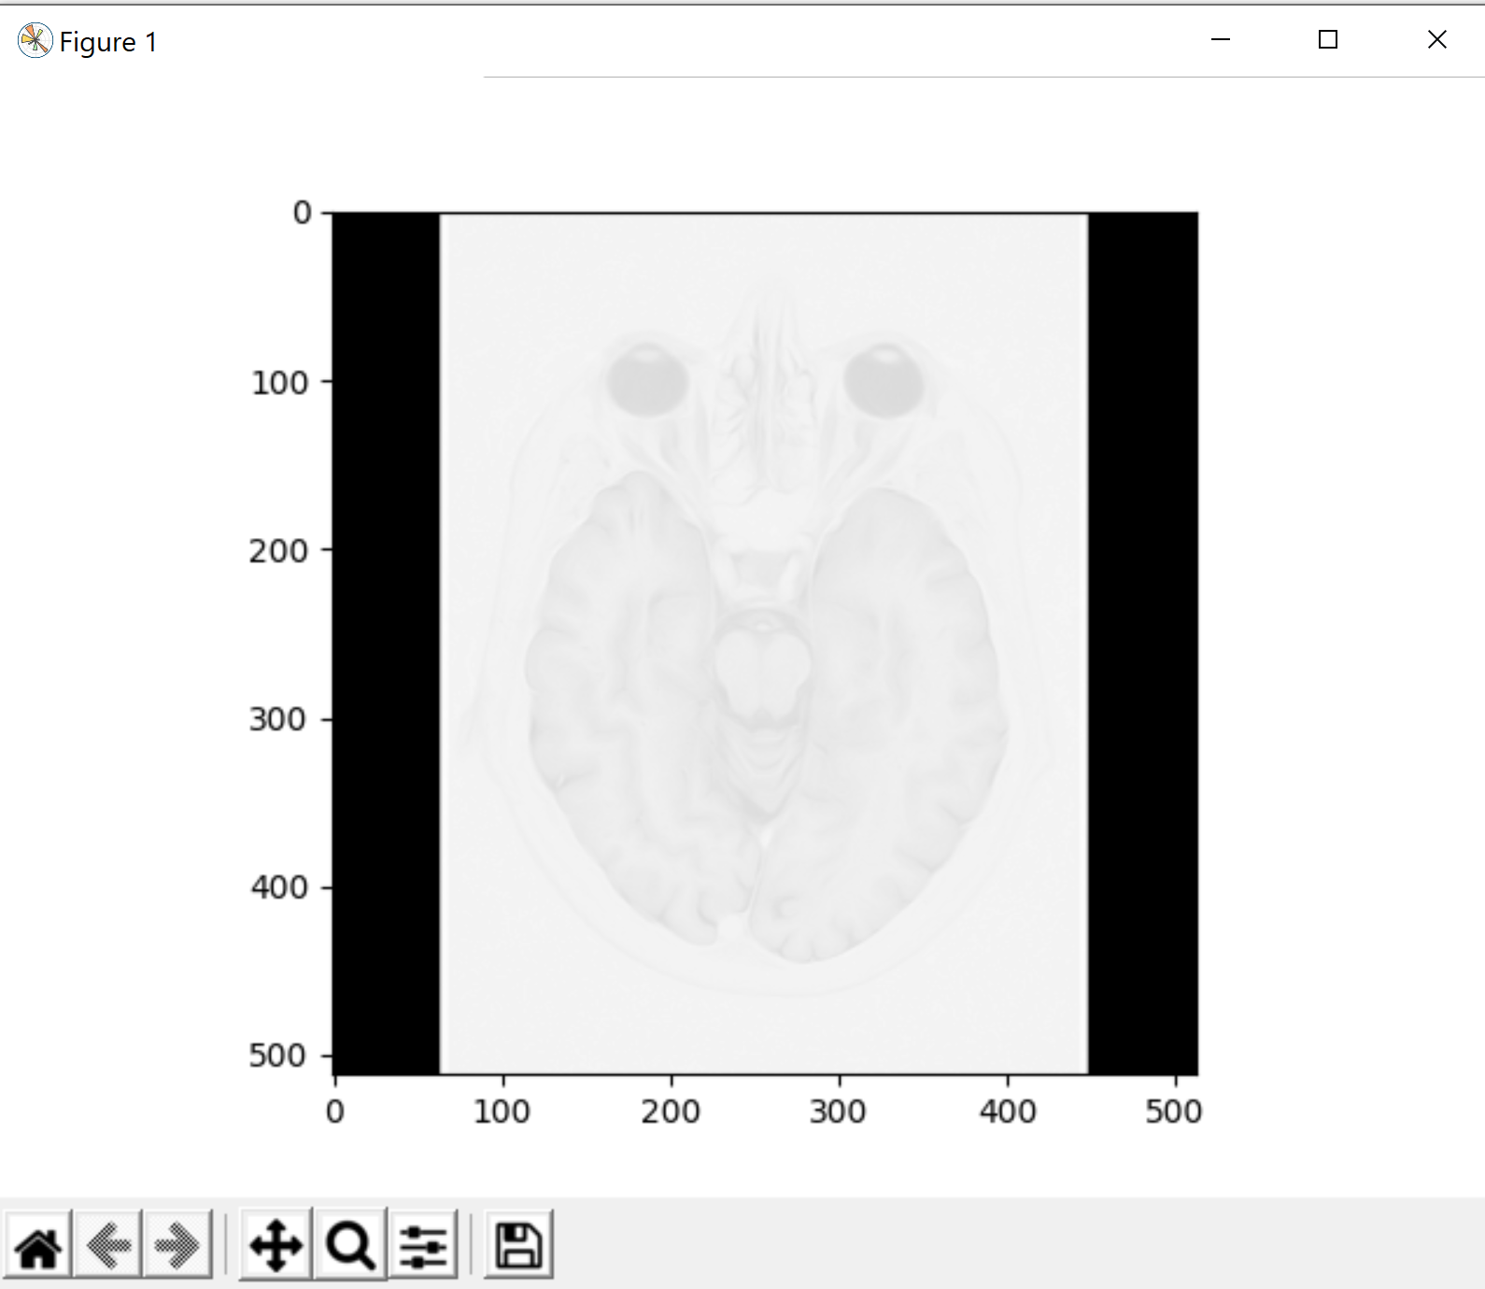

Slide 18
Fhir
We save the dicom details in a imagingstudy resource and it it shown at simplifier as :

Slide 19
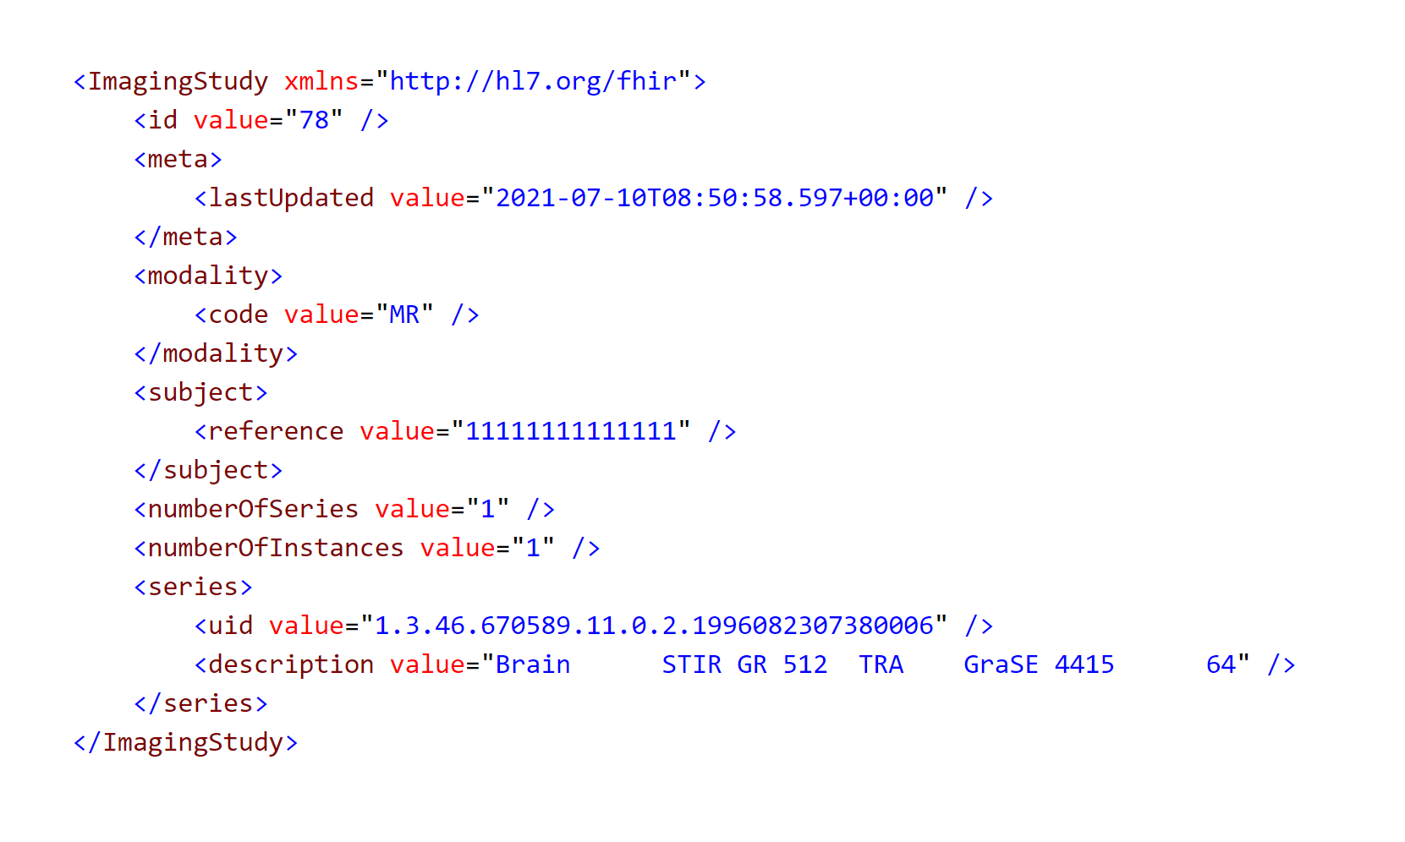

Slide 20
Project planning
Agile software planning including 5 stages
Brainstorming
UI design
UI implementation
Database development
Integration between front end/UI and database

Slide 21
Functional requirements
User login
Add records
Upload DICOM files
View records
View details

Slide 22
Non functional requirements
Performance requirements
Safety requirements
Reliability
Accessibility

Slide 23
Progress and backlog
Stage 1 (Brainstorming):
Identify problem ✔
Find different solutions and approaches ✔
Compare between different solutions and approaches ✔
Select best solution ✔
Setting a plan for the development ✔

Slide 24
Progress cont.
Stage 2 (UI design):
Shorting listing relative UIs ✔
Selecting best UI idea ✔
Making a blueprint ✔
Making a mockup ✔

Slide 25
Progress cont.
Stage 3 (UI implementation):
Searching about desktop UI in Django ✔
Selecting the suitable components for the UI ✔
Designing the “View Models” for the application ✔
Setting the UML diagrams ✔
Write down the flow of the app ✔
Start Coding ✔

Slide 26
Progress cont.
Stage 4 (Database Development):
Designing the database ✔
Use SQLite ✔
Making account on simplifier.net ✔
Generate token ✔
Find suitable resources that benefit our app ✔
Install fhirpy library ✔
Use ImageStudy resource ✔
Use HL7 to integrate between the systems ✔
Implementation of database ✔

Slide 27
Progress cont.
Stage 5 (Integration):
Make a Connection to the database ✔
Make functions in the database✔
Integrate the functions to the system✔

